Slide 1
Should you eat it?
Team Members:
Donicia Williams
Elizabeth Duenas
Gustavo Mendoza
Shahzad Naseer

Slide 2
TOPIC SELECTION
Fruits
Oranges
Apples
Bananas
Verdict
Rotten
File Size
X size
Tools Used
Flask
HTML/CSS/JS
Fresh
Heroku
Machine Learning

Slide 3
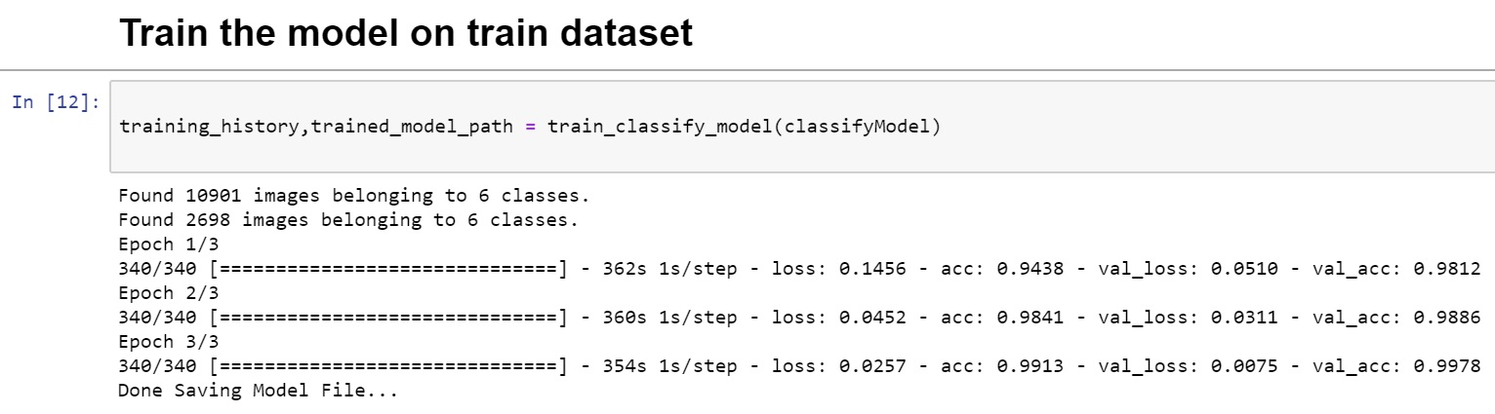
TRAINING
VGG16 (also called OxfordNet) is a convolutional neural network architecture named after the Visual Geometry Group from Oxford, who developed it. It was used to win the ILSVR (ImageNet) competition in 2014. To this day is it still considered to be an excellent vision model, although it has been somewhat outperformed by more revent advances such as Inception and ResNet.

Slide 4
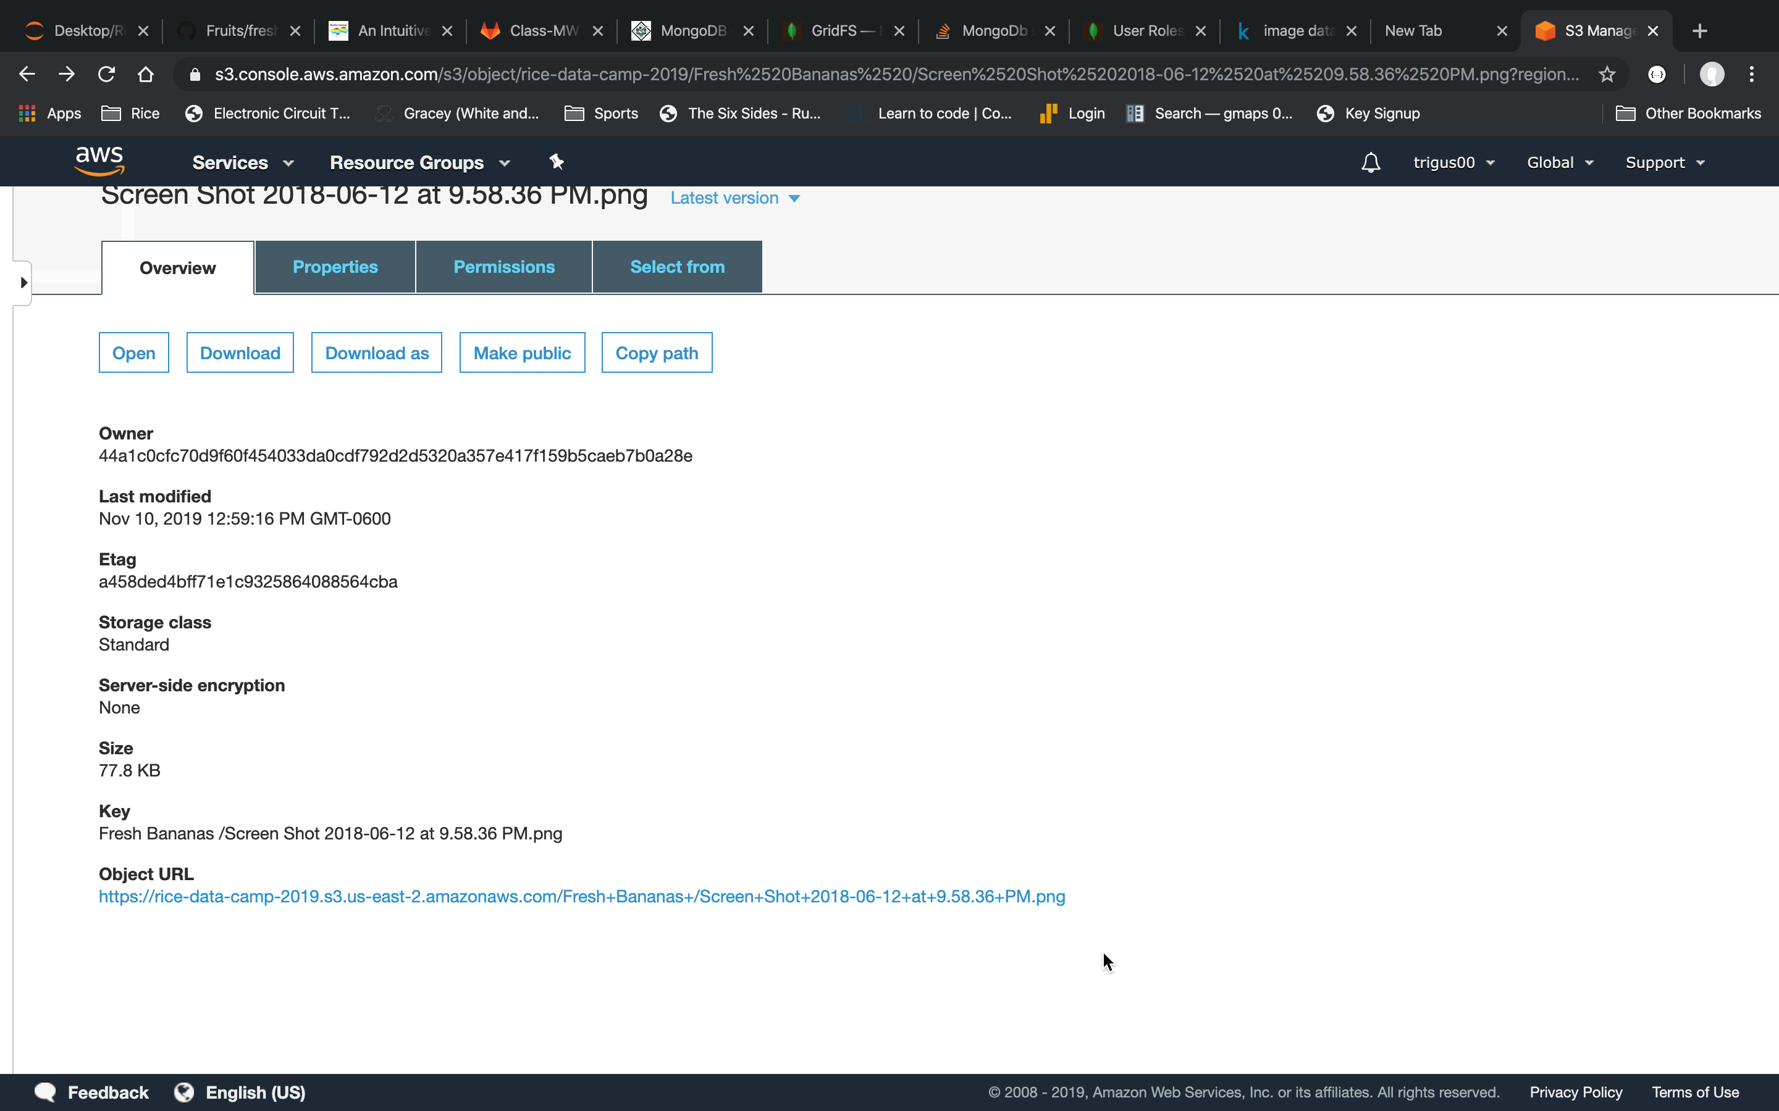

Slide 5
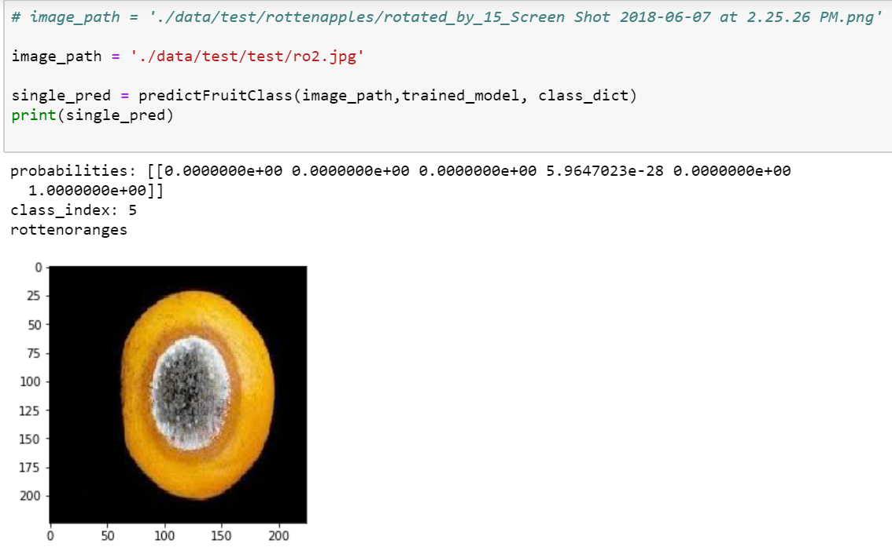
TESTING
ROTTEN ORANGE

Slide 6
VALIDATION
SLACK US A PICTURE OF:
ROTTEN BANANA
ROTTEN APPLE
ROTTEN ORANGE
FRESH BANANA
FRESH APPLE
FRESH ORANGE

